Slide 1


Coffee Shop Console
Juvina

Slide 2

Project Introduction
Coffee Shop console development in Java language. The console is only able to support 1 user (Administrator). The administrator can add, or modify the coffee options and the payment methods.

Slide 3
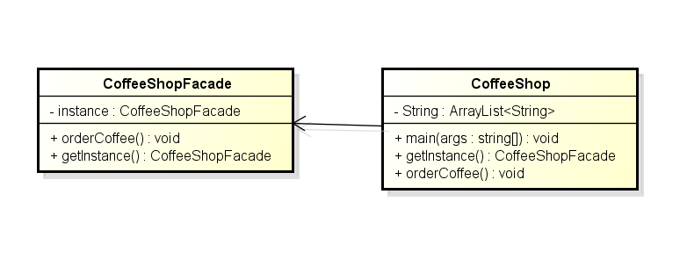
Facade and Singleton Pattern
Facade pattern: To abstract the inner working of the system.
Singleton pattern: Use only one instance of the Facade of the system. (The Singleton object doesn't retain any references of objects)

Slide 4
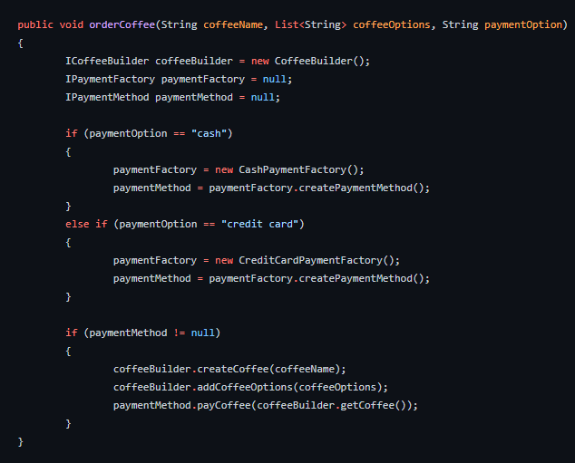
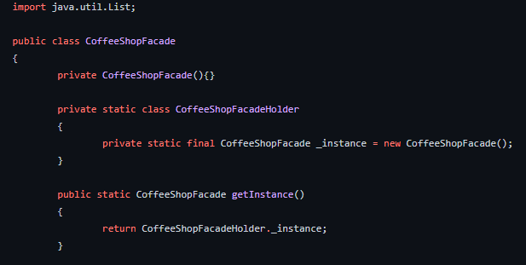
Facade Pattern

Slide 5
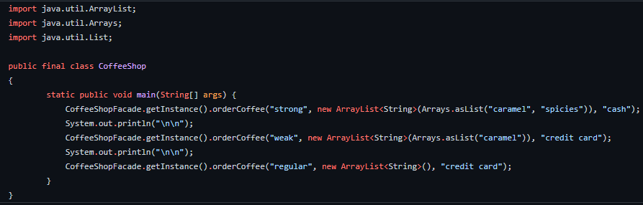
Singleton Pattern

Slide 6
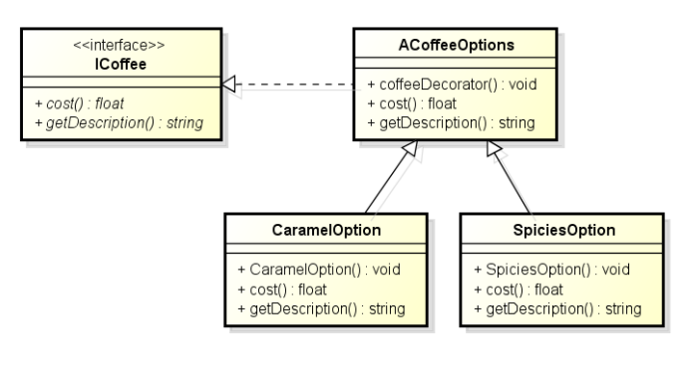
Decorator Pattern
Decorator pattern: To decorate a coffee beverage by adding options to it. There are 2 decorator classes for Coffee options such as Caramel option and Spicies Option.

Slide 7
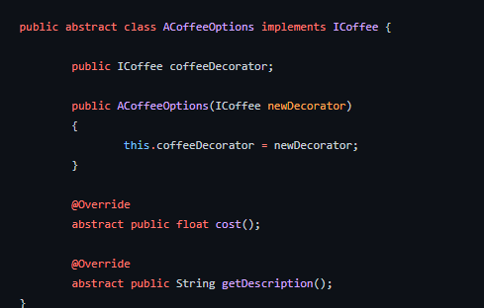
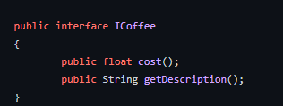
Decorator Pattern

Slide 8
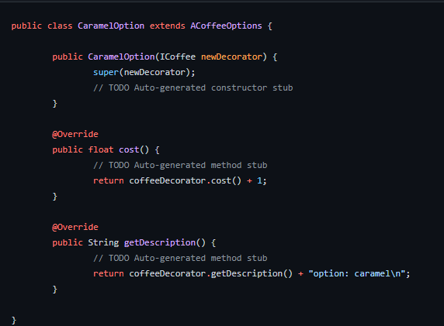
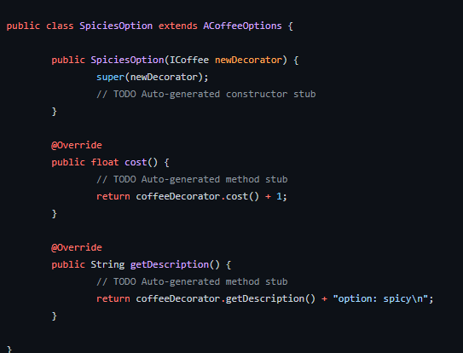
Decorator Pattern

Slide 9
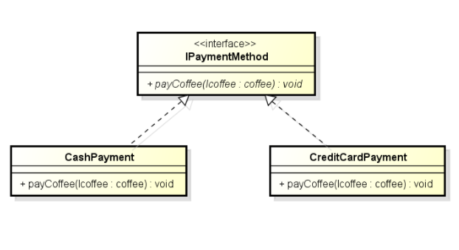
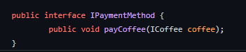
Strategy Pattern
Strategy pattern: To abstract the method of payment. The pattern strategy is used to make these changes unaffected by other code, thus avoiding unintended consequences for code and providing greater flexibility.

Slide 10
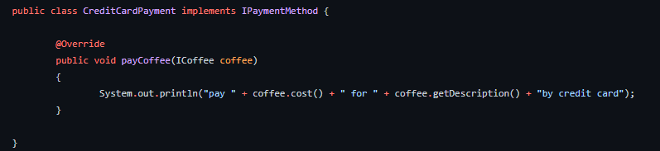
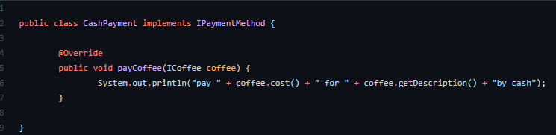
Strategy Pattern

Slide 11
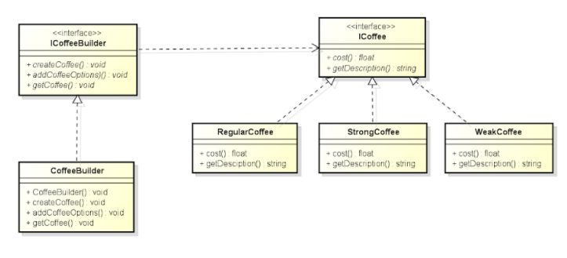
Builder Pattern
Builder pattern: To create a coffee beverage with a type of coffee and options to add. Builder design pattern is to separate the construction of a complex object from its representation with the example is ICoffee.

Slide 12
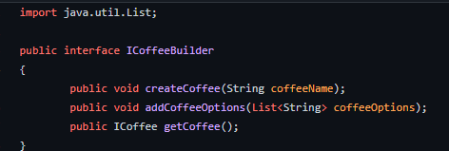
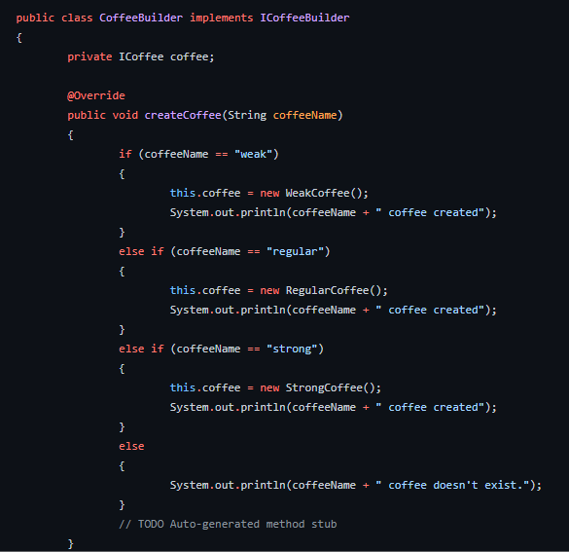
Builder Pattern

Slide 13
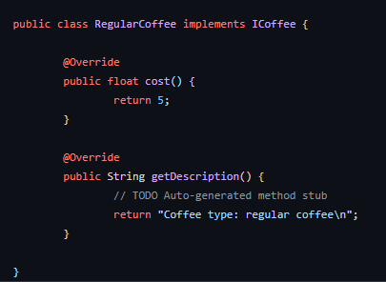
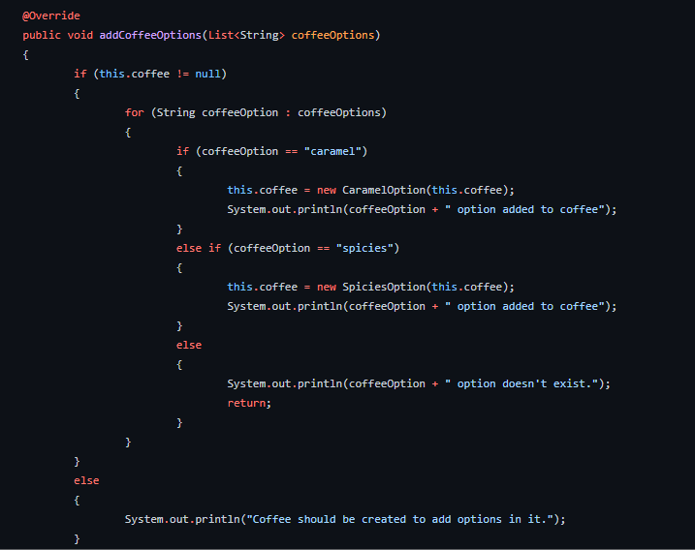
Builder Pattern

Slide 14
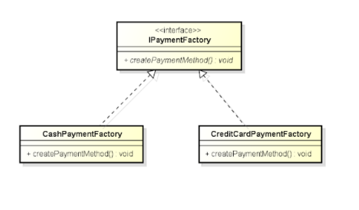
Abstract Factory
Abstract Factory design pattern: To abstract the creation of the desired method of payment.

Slide 15
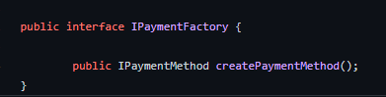
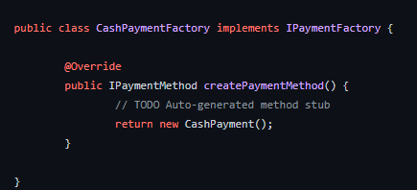
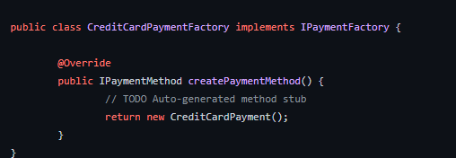
Abstract Factory

Slide 16
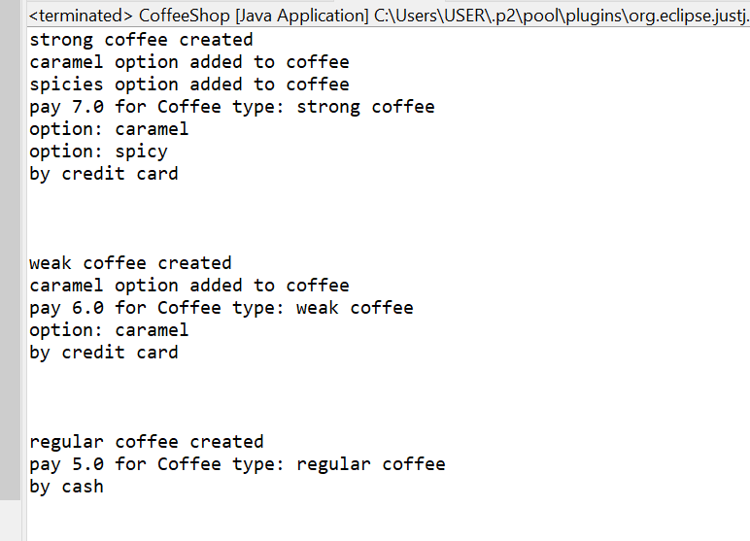
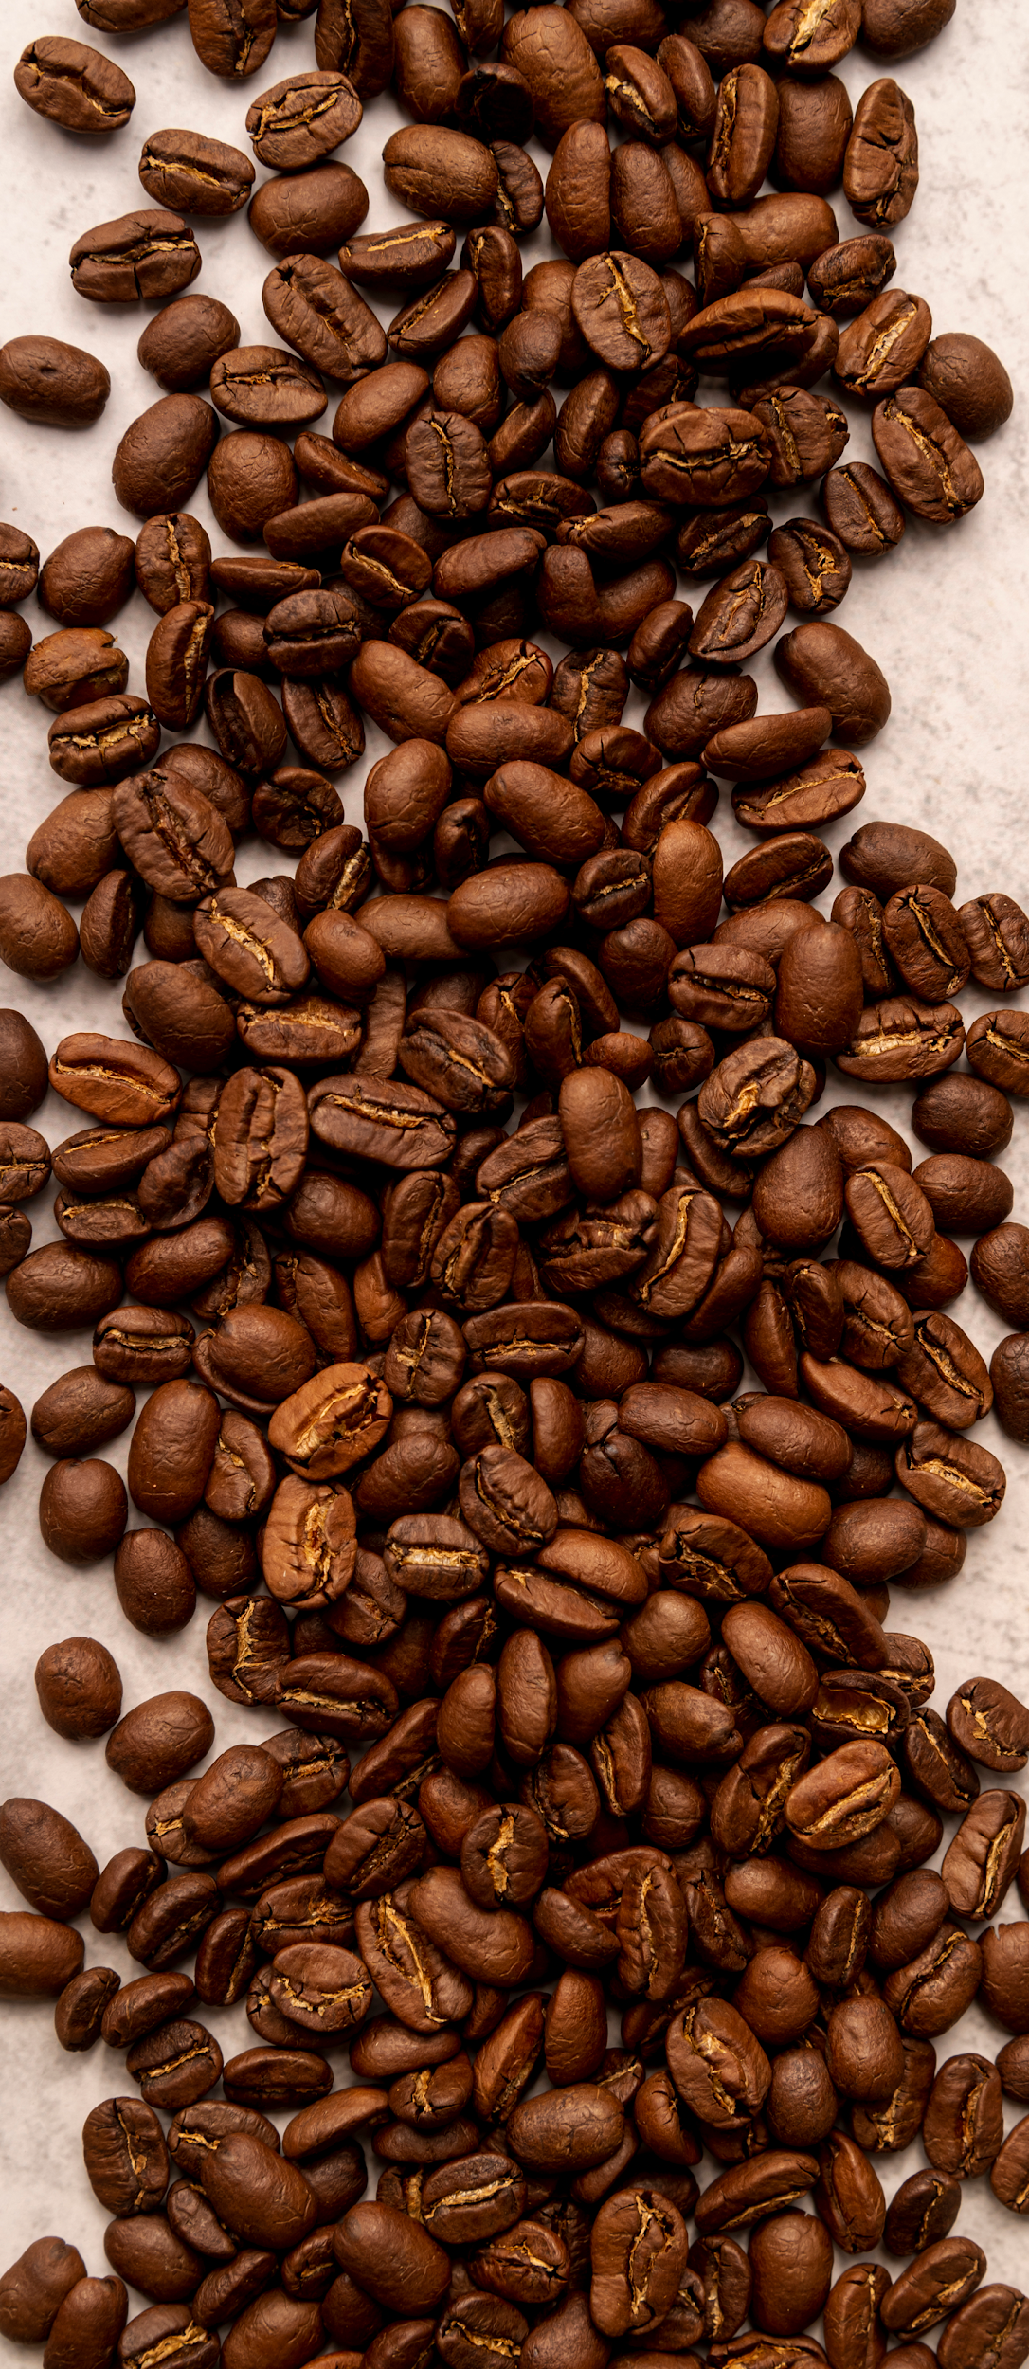
The Result

Slide 17

THANK YOU
DO YOU HAVE ANY QUESTIONS?

